Slide 1

8th Grade Math: Pre-Algebra
Unit 7, Lesson 1 Finding Slope Using Graphs and Tables Volume 1, pg. 281

Slide 2


Benchmark
MA.8.AR.3.2
Given a table, graph, or written description of a linear relationship, determine the slope.
volume 1, pg. 281

Slide 3
Integrated Mathematical Thinking and Reasoning Standards
MA.K12.MTR.4.1 Engage in discussions that reflect on the mathematical thinking of self and others.
MA.K12.MTR.6.1 Assess the reasonableness of solutions.
volume 1, pg. 281

Slide 4

Learning Targets
I can determine the slope of a line from a graph or a table, given a mathematical context.
I can relate the slope as the rate of change of the relationship between variables.
volume 1, pg. 281

Slide 5

Warm-Up
volume 1, pg. 281

Slide 6

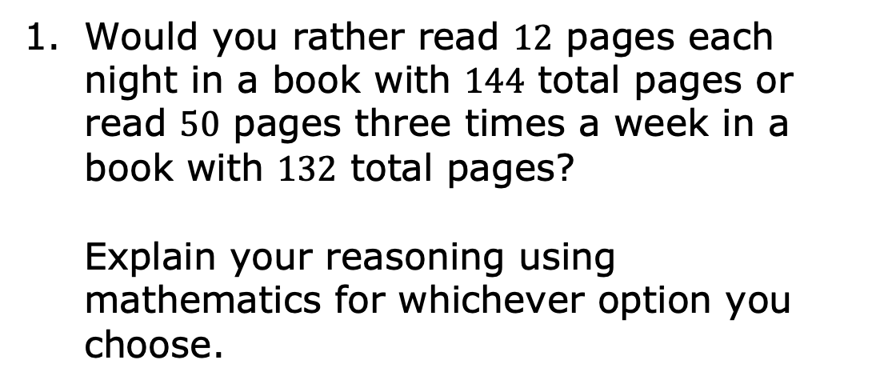
7.1.1 Warm-Up: Would You Rather?
Would you rather read $12$ pages each night in a book with $144$ total pages or read $50$ pages three times a week in a book with $132$ total pages?
Explain your reasoning using mathematics for whichever option you choose.
volume 1, pg. 281

Slide 7

Refresher
volume 1, pg. 282

Slide 8

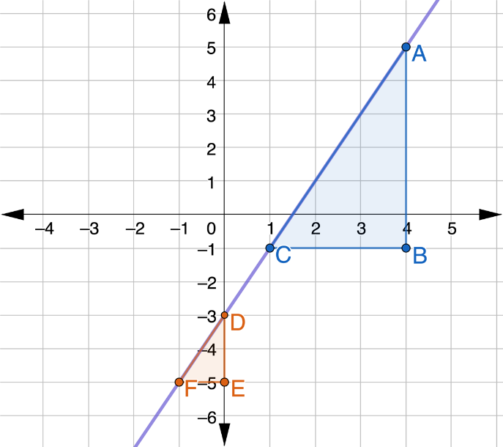
7.1.2 Refresher: Using Similar Triangles to Find the Slope of a Line
Similar triangles can be used to determine the slope of a line by comparing the ratio of vertical lengths to horizontal lengths of the triangles.
volume 1, pg. 282

Slide 9
For each triangle, label the ordered pairs of each vertex.
What is the length of the vertical leg of the blue triangle?
How could you use the coordinates of the vertices of the vertical leg to find its length?
volume 1, pg. 282

Slide 10

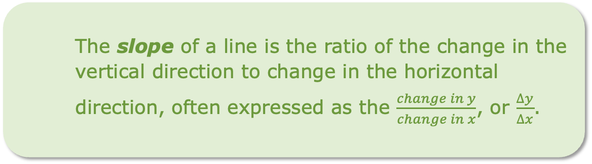
What is the length of the horizontal leg of the blue triangle?
How could you use the coordinates of the vertices of the horizontal leg to find its length?
The slope of a line is the ratio of the change in the vertical direction to change in the horizontal direction, often expressed as the $\frac{change in y}{change in x}$, or $\frac{∆y}{∆x}$.
volume 1, pg. 282

Slide 11
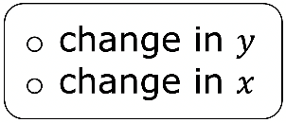
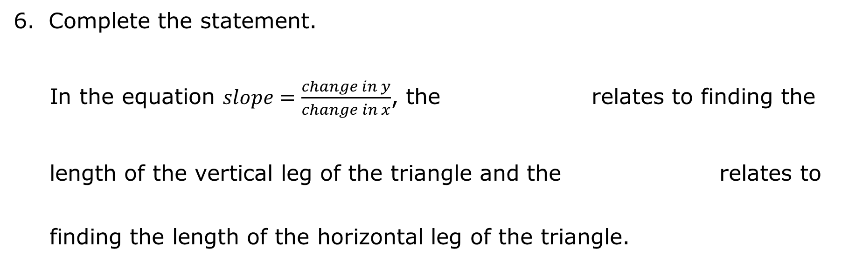
Complete the statement.
In the equation $slope=\frac{change in y}{change in x}$, the relates to finding the length of the vertical leg of the triangle and the relates to finding the length of the horizontal leg of the triangle.
volume 1, pg. 282

Slide 12
Use the coordinates of the vertices of the blue triangle to find the slope of the purple line. Show your work or explain what you did.
Use the coordinates of the vertices of the orange triangle to find the slope of the purple line. Show your work or explain what you did.
volume 1, pg. 283

Slide 13
Check your answers with your partner.
Make a conjecture about whether the order in which you subtract to find the change in 𝑥 and change in 𝑦 matters.
volume 1, pg. 283

Slide 14

Collaboration
volume 1, pg. 283

Slide 15

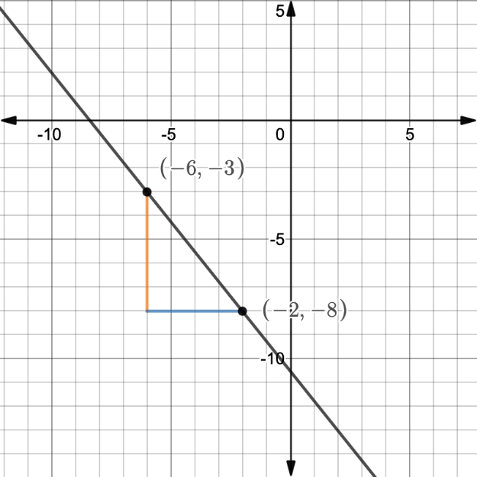
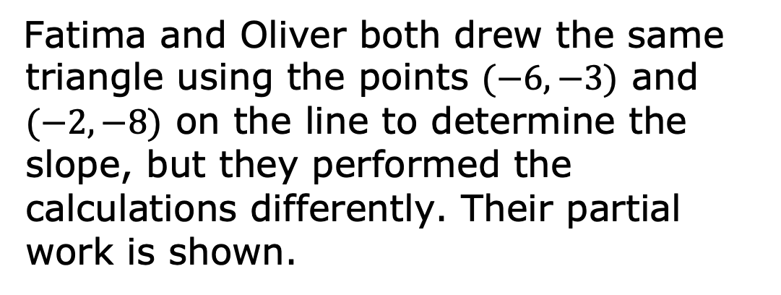
7.1.3 Collaboration: Finding Slope from Graphs
Fatima and Oliver both drew the same triangle using the points $(−6, −3)$ and $(−2, −8)$ on the line to determine the slope, but they performed the calculations differently. Their partial work is shown.
volume 1, pg. 283

Slide 16
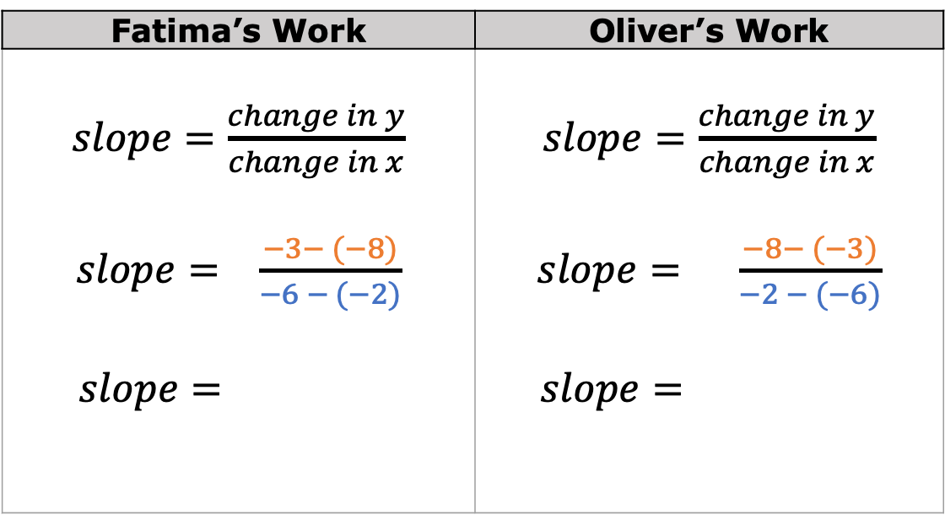
With your partner, complete each student’s work and answer the questions that follow.
Fatima’s Work | Oliver’s Work
$slope=\frac{change in y}{change in x}$ $slope= \frac{−3− (−8)}{−6 − (−2)}$ $slope=$ | $slope=\frac{change in y}{change in x}$ $slope= \frac{−8− (−3)}{−2 − (−6)}$ $$slope=$$
volume 1, pg. 283

Slide 17
Fatima compared her work to Oliver’s and said, “It doesn’t matter which order we subtracted the values. We found the same slope.” Explain why you agree or disagree.
Oliver said, “It doesn’t matter which order you subtract, but whichever coordinate pair you start with to find the change in 𝑦, you have to also start with its 𝑥-value when finding the change in 𝑥.” What do you think Oliver meant?
volume 1, pg. 284

Slide 18

Guided Instruction
volume 1, pg. 284

Slide 19

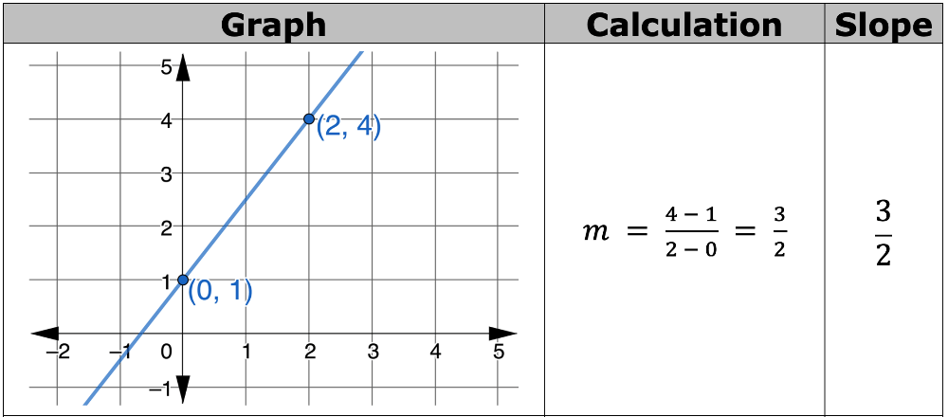
7.1.4 Guided Instruction: Finding Slope from Graphs and Tables
The slope of any line can be determined from a graph using any two points on the line.
Three graphs and the calculations used to determine their slope are shown.
volume 1, pg. 284

Slide 20
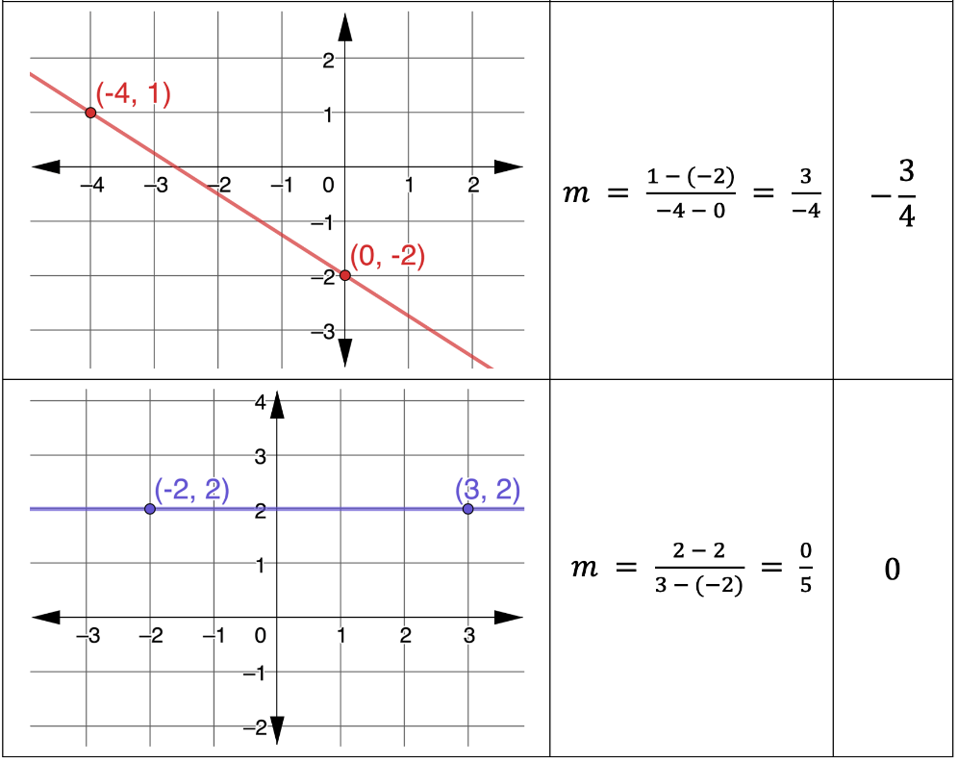
volume 1, pg. 284

Slide 21
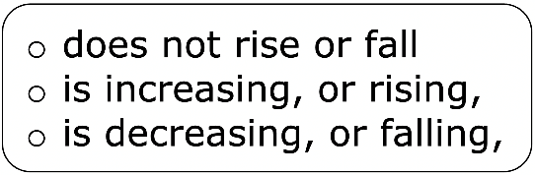
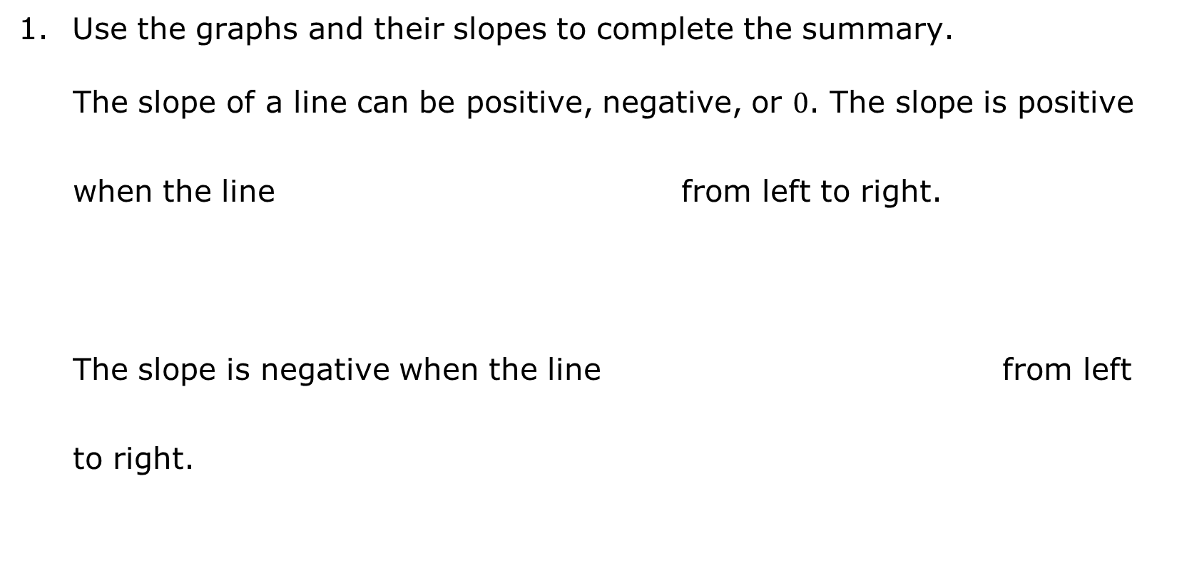
Use the graphs and their slopes to complete the summary.
The slope of a line can be positive, negative, or $0$. The slope is positive when the line from left to right.
The slope is negative when the line from left to right.
volume 1, pg. 285

Slide 22
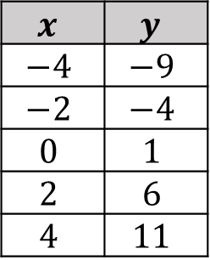
The slope is $0$ when the line from left to right.
Recall that linear relationships can also be represented using tables of values.
The table to the right represents a linear relationship.
$$x$$ | $$y$$
$$−4$$ | $$−9$$
$$−2$$ | $$−4$$
$$0$$ | $$1$$
$$2$$ | $$6$$
$$4$$ | $$11$$
Notice that the 𝑥-values in the table are increasing by the same amount in each row.
volume 1, pg. 285

Slide 23
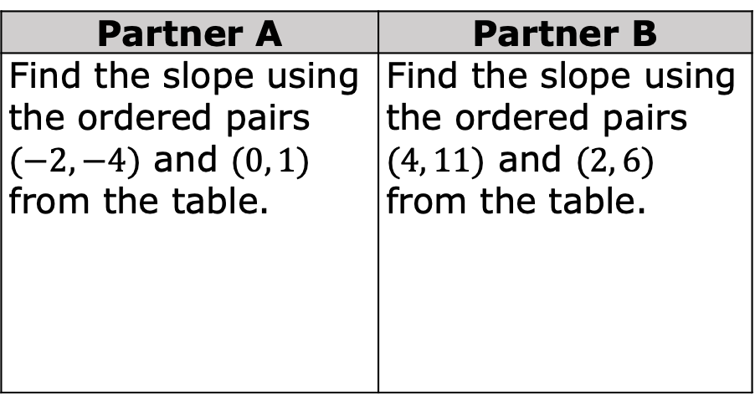
How are the 𝑦-values in the table changing as the 𝑥-values increase by 2?
With your partner, decide who will be Partner A and who will be Partner B. Then, find the slope of the linear relationship using the ordered pairs indicated below.
Show your work in the space provided.
Partner A | Partner B
Find the slope using the ordered pairs $(−2, −4)$ and $(0, 1)$ from the table. | Find the slope using the ordered pairs $(4, 11)$ and $(2, 6)$ from the table.
volume 1, pg. 285

Slide 24
Check your work with your partner.
volume 1, pg. 285

Slide 25

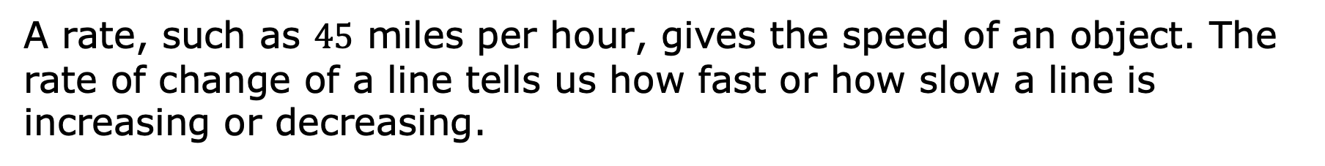
The slope of any line can be determined from a table of values using any two ordered pairs in the linear relationship because the rate of change in a linear relationship is constant.
The rate of change is the ratio of change in one quantity to the corresponding change in another quantity.
A rate, such as $45$ miles per hour, gives the speed of an object. The rate of change of a line tells us how fast or how slow a line is increasing or decreasing.
volume 1, pg. 286

Slide 26
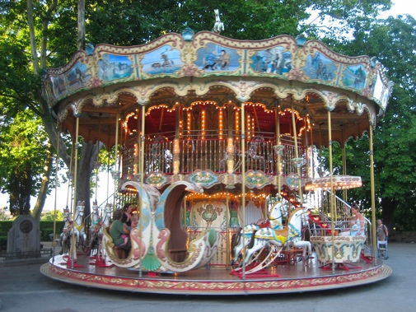
Rates can be constant. For example, the speed of a horse on a carousel is constant while the ride is in motion, but the speed of someone riding on a merry-go-round is not constant because it can change depending on how fast or slow the merry-go-round is being pushed.
volume 1, pg. 286

Slide 27
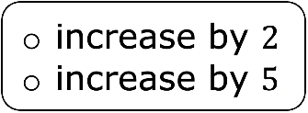
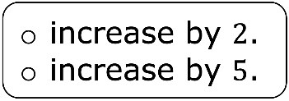
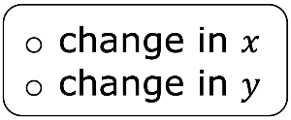
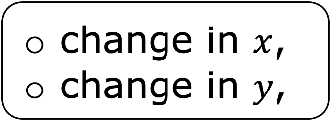

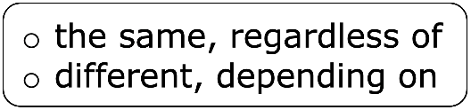
Complete the summary to describe the relationships between the quantities observed for the linear relationship represented by the table of values.
The 𝑦-values in the table each time the 𝑥-values Slope is the over the or in this case. The slope, or rate of change, is constant for linear relationships, so the slope is which two ordered pairs on the line are used to calculate it.
volume 1, pg. 286

Slide 28
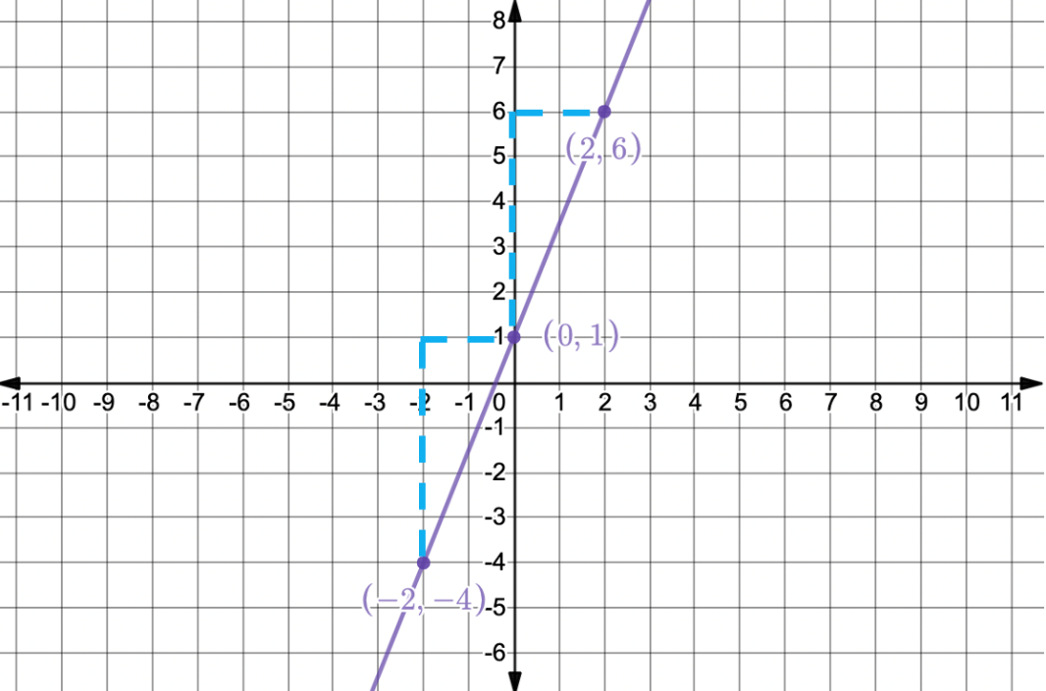
This means that the line is increasing or decreasing at the same rate between every point along the line. That is why it forms a straight line, as shown on the graph.
volume 1, pg. 286

Slide 29

Your Turn
volume 1, pg. 287

Slide 30

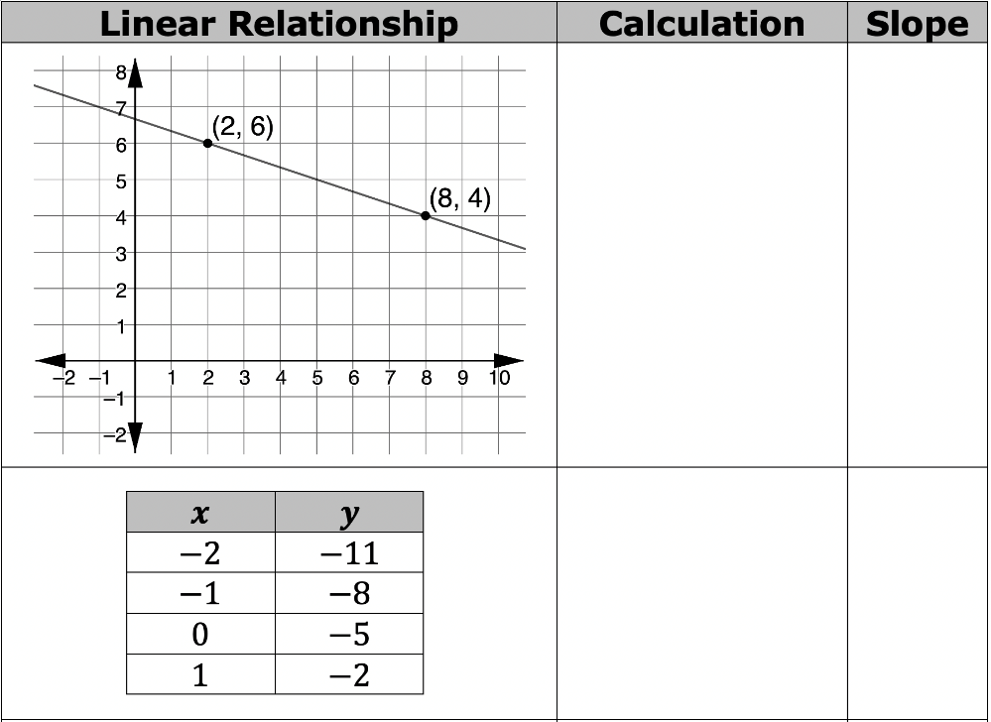
7.1.5 Your Turn!
Determine the slope of each linear relationship.
volume 1, pg. 287

Slide 31
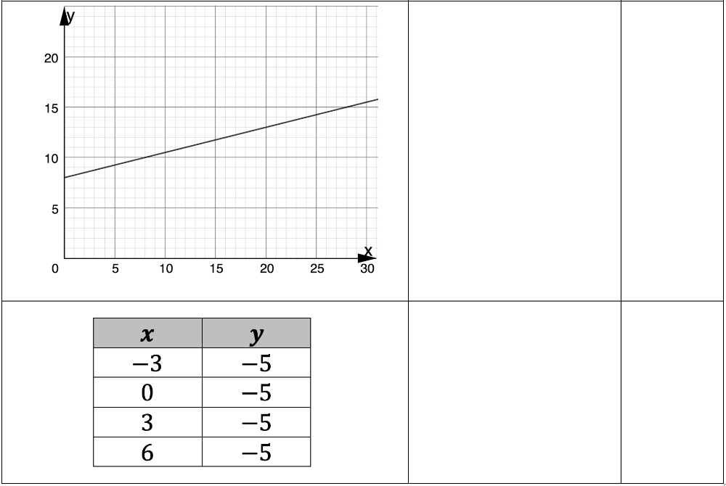
volume 1, pg. 287

Slide 32

Wrap-Up
volume 1, pg. 287

Slide 33
7.1.6 Wrap-Up: Reflection
Draw an X on each line to indicate where your current level of understanding is related to each target.
I can determine the slope of a line from a graph or a table, given a mathematical context.
I need help. I can’t get started. | I’m getting there, but I need more practice. | I understand this and I feel confident.
I can relate the slope to the rate of change of the relationship between variables.
I need help. I can’t get started. | I’m getting there, but I need more practice. | I understand this and I feel confident.
volume 1, pg. 287

